Slide 1


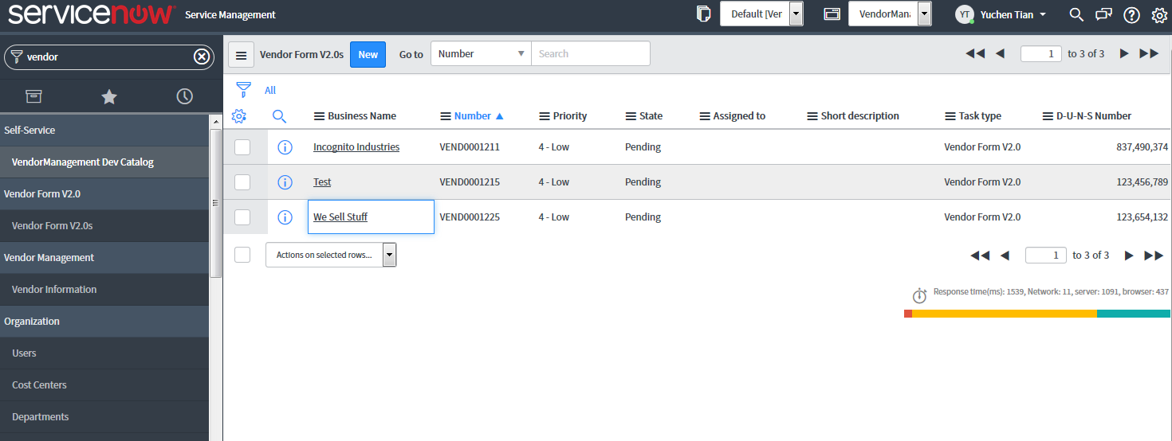
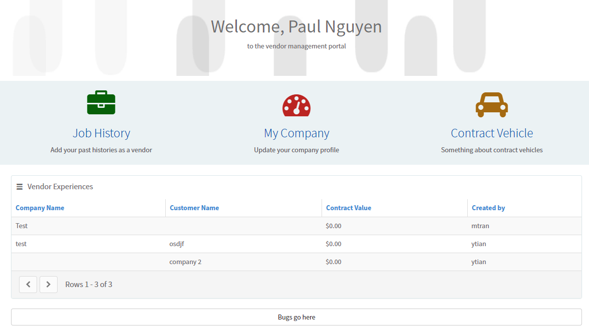


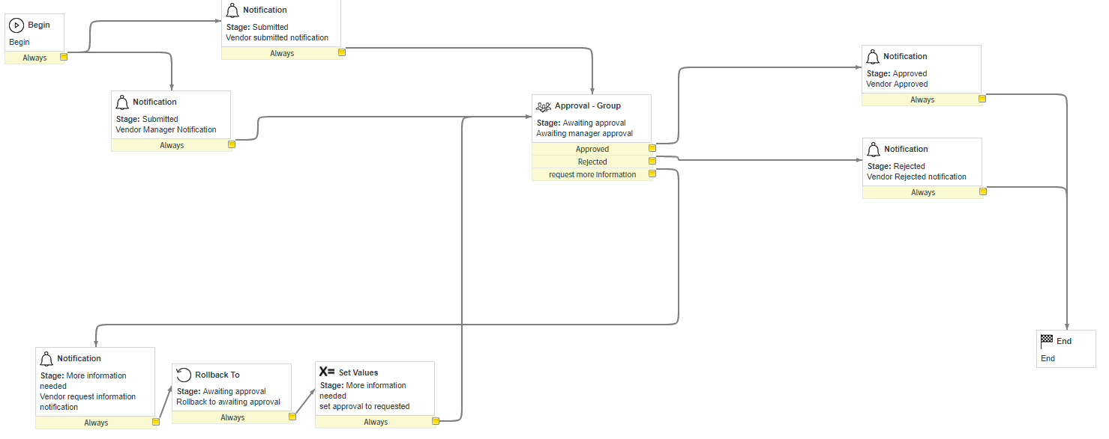


301
Vendor Management Portal
Team members: Paul Nguyen, Michael Tran, Yuchen Tian | Faculty adviser: Robert Dahlberg | Sponsor: Bravium Consulting Inc. | Mentor: Nic Skirpan
Vendor Management
Solution
Technologies
What it is
Businesses will often work with other companies for products or services. This introduces tons of paperwork.
What should be done
There needs to be a streamlined solution to minimize the time wasted on managing and maximize the time spent on working.
Requirements
The solution must satisfy the needs for all three stakeholders: business, vendor manager, and vendors.
ServiceNow Application
Service Portal: Front end for vendors to apply for jobs, complete profiles, search relevant information, etc.
Service Management: Back end for vendor managers and the business to organize and analyze vendors, post new contracts, etc.
Workflow
The application is based on workflows created in ServiceNow. Activities such as scripts, record generation, and user notification are automated under the workflow.
ServiceNow is a platform-as-a-solution that provides business management software as a service. It specializes in IT services management (ITSM), IT operations management (ITOM) and IT business management (ITBM).
ServiceNow offers Glide, an extensible Web 2.0 platform that facilitates with the development of workflow and form based applications.
Service Management
Vendor Workflow
Service Portal

